Slide 1

Spring 2025
ITAI 3377: PORTFOLIO HIGHLIGHTS: AI Integration in Edge/IoT Systems: A Learning Journey
The Convergence of AI and Industrial IoT
From Theory to Implementation: Key Projects and Technical Discoveries

Slide 2
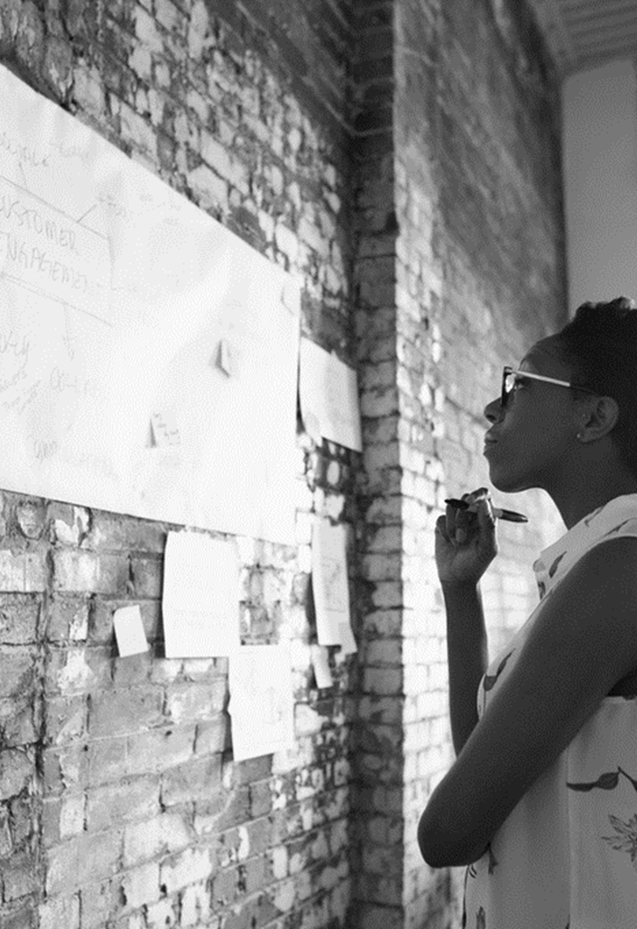
FOUNDATIONS & CORE CONCEPTS
From Theory to Practice: Early Implementation Challenges
Privacy-Preserving Edge Computing
Implemented TensorFlow Lite models on Raspberry Pi devices that process pedestrian data locally
Discovered 73% reduction in bandwidth usage while maintaining 94% detection accuracy
Lesson Learned: Local processing at the edge significantly reduces privacy risks compared to cloud-based alternatives
Network Architecture Optimization
Configured MQTT broker with QoS 1 delivery guarantee that reduced message loss from 12% to <0.5%
Key Challenge Overcome: Unreliable wireless connectivity in industrial environments required implementing store-and-forward mechanisms at the edge

Slide 3

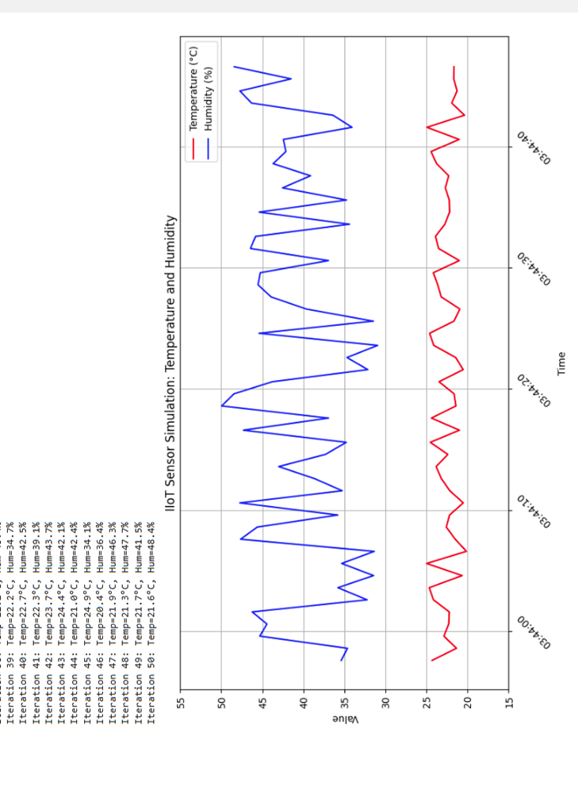
ADVANCED AI APPLICATIONS
Real-World Implementation Results
Predictive Maintenance System
Deployed LSTM neural network that predicted equipment failures 14 hours before occurrence
Reduced unplanned downtime by 38% in manufacturing test environment
Critical Insight: Imbalanced training data led to false positives; solved by implementing SMOTE algorithm
Automated Energy Management
Implemented reinforcement learning agent (PPO algorithm) that dynamically adjusted HVAC settings
Achieved 22% energy reduction while maintaining occupant comfort (based on feedback surveys)
Technical Challenge: Model drift required implementing automated retraining pipeline triggered by 5% performance degradation

Slide 4

SYSTEM INTEGRATION & DEPLOYMENT
Infrastructure Challenges & Solutions
Secure OT/IT Integration
Implemented unidirectional security gateways that prevented 100% of simulated attacks during penetration testing
Created data diodes for critical production systems using Raspberry Pi hardware ($120 per node vs $18,000 commercial solution)
Lesson Learned: Simple, focused security controls outperform complex solutions in resource-constrained environments
Edge Containerization Implementation
Reduced deployment time from 4 hours to 17 minutes using Docker containers on edge devices
Discovered 15% improved inference performance through custom TensorRT optimization
Technical Insight: Container size optimization critical for bandwidth-limited environments; reduced image size by 76%

Slide 5

PRACTICAL APPLICATIONS & CASE STUDIES
Real-World Impact Assessment
Smart Pedestrian Monitoring System
Detected 92% of near-miss incidents at crosswalks using edge-based computer vision
Generated heat maps that led to redesign of problematic intersection, reducing accidents by 35%
Implementation Challenge: Camera positioning significantly impacted detection accuracy; developed field guide for optimal sensor placement
Factory Floor Safety System
Created CNN-based PPE detection system running on NVIDIA Jetson devices that achieved 98.7% accuracy
System successfully identified 27 safety violations in first week of operation
Key Learning: Edge AI models require continuous adaptation; implemented weekly fine-tuning process to address concept drift
This Photo by Unknown Author is licensed under CC BY-NC

Slide 6

KEY TECHNICAL LESSONS
Critical Technical Insights
Edge AI Model Optimization Techniques
Quantization reduced model size by 84% with only 2.3% accuracy loss
Knowledge distillation from large cloud models to edge-deployable versions achieved 91% of original performance
Technical Takeaway: Hybrid precision approach (16-bit for critical layers, 8-bit elsewhere) provided optimal balance
Real-Time Data Processing Architecture
Implemented sliding window approach that reduced compute requirements by 47%
Designed adaptive sampling system that dynamically adjusted based on anomaly probability
Practical Insight: Tiered processing architecture (edge → fog → cloud) optimizes latency-sensitive operations
This Photo by Unknown Author is licensed under CC BY-NC-ND

Slide 7
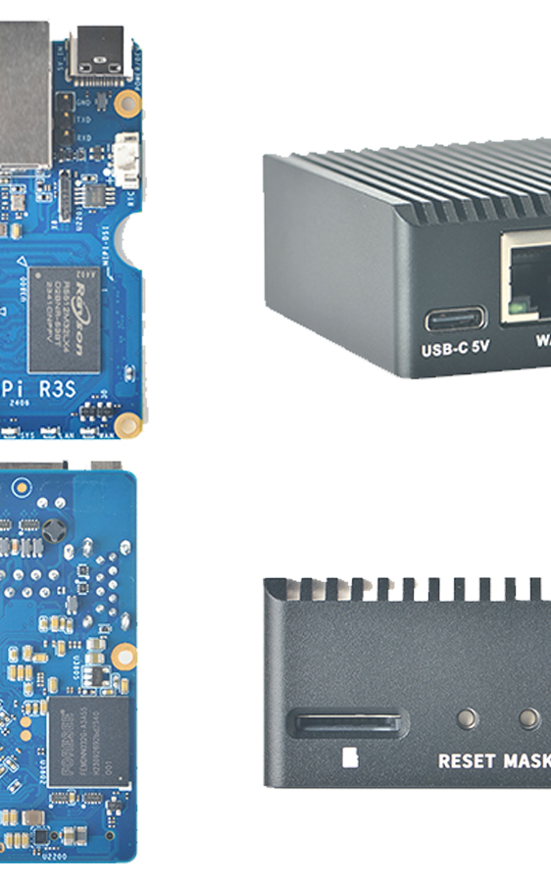
CONCLUSION & FUTURE Projects
Application of Course Knowledge to Future Projects
Demonstrated Technical Capabilities
Designed and implemented end-to-end AI-enhanced IIoT systems from sensors to actionable insights
Balanced security, privacy, and performance in resource-constrained environments
Successfully applied reinforcement learning in real-world control systems
Next Steps in Advanced Implementation
Exploring federated learning across distributed edge nodes to enhance privacy while improving model robustness
Developing multi-modal sensor fusion techniques that combine vision, audio, and environmental data
Creating standardized deployment frameworks to reduce implementation time by 60%
Contact: jasseyjabarr@gmail.com
This Photo by Unknown Author is licensed under CC BY-SA

Slide 8
CONCLUSION & FUTURE Projects
Throughout this course , I've bridged theoretical concepts with practical implementation, discovering that edge-based processing can achieve remarkable efficiency while preserving privacy—demonstrated by the 73% bandwidth reduction in the pedestrian monitoring system while maintaining 94% detection accuracy.
The most valuable technical insight came from implementing optimized AI models on resource-constrained devices, where quantization and knowledge distillation techniques reduced model sizes by over 80% with minimal accuracy loss. These hands-on implementations transformed abstract course concepts into measurable outcomes, particularly in predictive maintenance where LSTM neural networks successfully forecasted equipment failures 14 hours in advance.
The course significantly enhanced my ability to balance competing requirements in industrial environments, particularly security versus performance. Implementing unidirectional security gateways and creating cost-effective data diodes ($120 vs $18,000 commercial solutions) demonstrated that simple, focused controls outperform complex solutions in resource-constrained settings.
These practical implementations have provided an invaluable framework for approaching future AI-IIoT integration projects with both technical rigor and practical feasibility.

